Slide 1
Design and Analysis of Algorithms
National University of Computer and Emerging Sciences, Islamabad

Slide 2
Divide and Conquer
Hard Problem
Easy Problem
Hard Problem
Easy Problem
Easy Problem
Easy Problem

Slide 3
Divide & Conquer
Divide & conquer paradigm involves 3 steps:
  Divide the problem into independent sub-problems
  Conquer the sub-problems
  Combine the solutions of the sub-problems.
This nature of divide & conquer algorithms automatically leads to recursion.
Classic examples:
  Merge sort : T(n) = 2T(n/2) + O(n)
  Binary search: T(n) = T(n/2) + O(1)

Slide 4
Example: Min-Max Problem
Problem: Find the largest (heaviest) and smallest (lightest) elements in a set of n elements
Simple Algorithm: Make n-1 comparisons to find largest, n-2 more comparisons to find smallest for a total of 2n-3 comparisons.

Slide 5
Min-Max Cont’d
Divide-and-Conquer:
  For n ≤ 2, make 1 comparison
  For large n, divide set into two smaller sets and determine largest/smallest element for each set
  Compare largest/smallest from two subsets to determine smallest/largest of combined sets
  Do recursively
Let n =8
How many comparisons?

Slide 6
Example: Min-Max Problems
8
4
4
Each Li and Si in 4 comparisons
Max (Li) = 3 comparisons
Min (Si) = 3 comparisons
Total = 10 comparisons
1 2 3 4
2
2
2
2
S2
L3
S3
L4
S4
L1
S1
L2

Slide 7
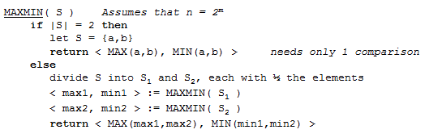

Slide 8
Misc
Divide-and-Conquer methodology naturally leads to recursive algorithms
In general, implement algorithm as recursive program
  Few instances where non-recursive is better
Rule of thumb: Balance sub-problems, i.e., try and make sub-problems of equal size
  See merge sort

Slide 9
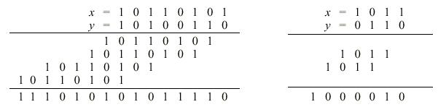
MULTIPLICATION OF TWO n-BIT NUMBERS
For this problem, the basic operations should be bit operations.
Let X and Y be two n-bit numbers, the traditional method requires O(n²) bit operations, say

Slide 10
MULTIPLICATION OF TWO n-BIT NUMBERS (cont.)
Assume n=2^{m}, we treat X and Y as two n-bit strings and partition them into two halves as X = AB, Y= CD, i.e., concatenation of A, B and C, D. As binary numbers, we can express
XY = (A2^{n/2} + B) (C2^{n/2} + D)
= AC2^{n} + (AD + BC) 2^{n/2} + BD ............ (*)
The above computation of XY reduces to four multiplications of (n/2)-bit numbers plus some additions and shifts (multiplications by powers of 2).

Slide 11
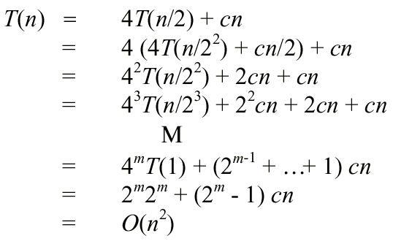
Two n-bits Number Analysis
Let T(n) be the number of bit-operations required to multiply two n-bit numbers.

Slide 12
A better Algorithm
So, the multiplication of two n-bit numbers remains O(n²) if the number of half-size subproblems remains 4
To reduce time complexity, reduce number of subproblems (i.e., multiplications ) by a “trick” which uses more additions and shifts, specifically, by reducing one multiplication with many additions and shifts.
This trick pays off asymptotically, i.e., when n is large.

Slide 13
A better Algorithm (cont.)
  u = (a + b) * (c + d)
  v = a * c
  w = b * d
  z = u - v - w = ad + bc
So, XY can be written as V2^{n}+ Z2^{n/2} + W (from Eq (*)).
This approach requires only three multiplications of two (n/2)-bit numbers, plus some additions and shifts, to multiply two n-bit numbers.
…Multiplication-1
…Multiplication-2
…Multiplication-3

Slide 14
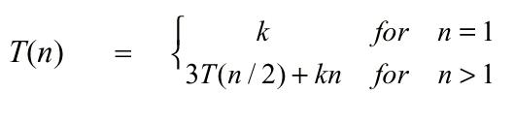
Analysis
Use multiplication routine recursively to get products u, v, and w, additions and shifts require O(n) time. Thus time complexity of multiplying two n-bit numbers is bounded from above by
Where k is a constant reflecting the additions and shifts. The solution to the recurrence is O(n ^{log3}) = O(n ^{1.59}).

Slide 15
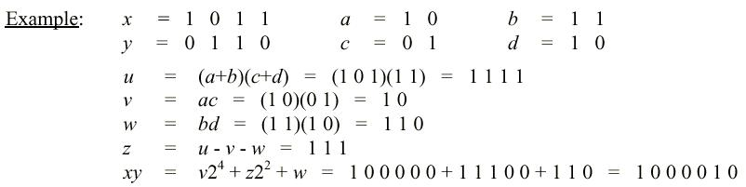
Example
This divide&conquer technique for multiplying two n-bit numbers can also be used to multiply of two n-digit integers and n-degree polynomials.

Slide 16
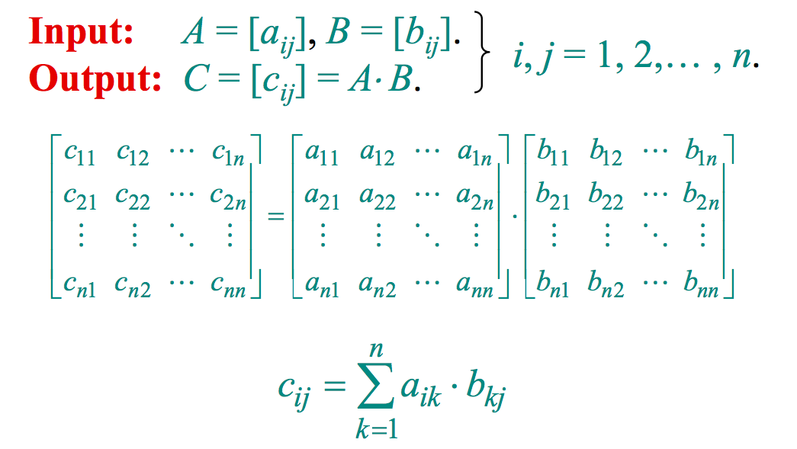
Matrix Multiplication

Slide 17
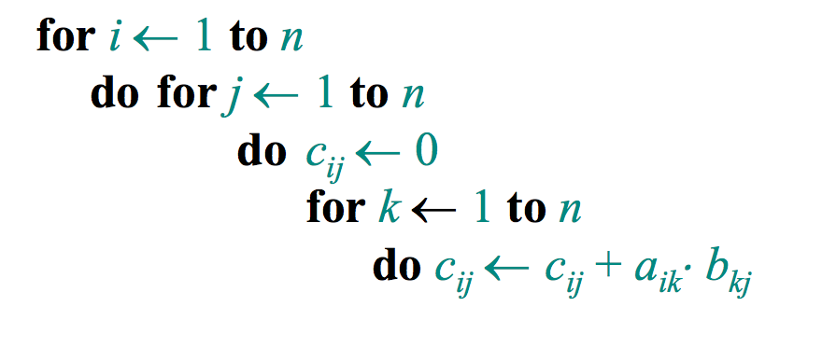
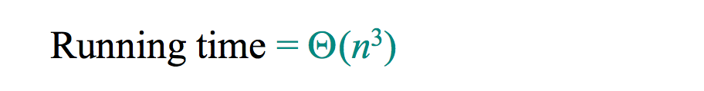
Standard Algorithm

Slide 18
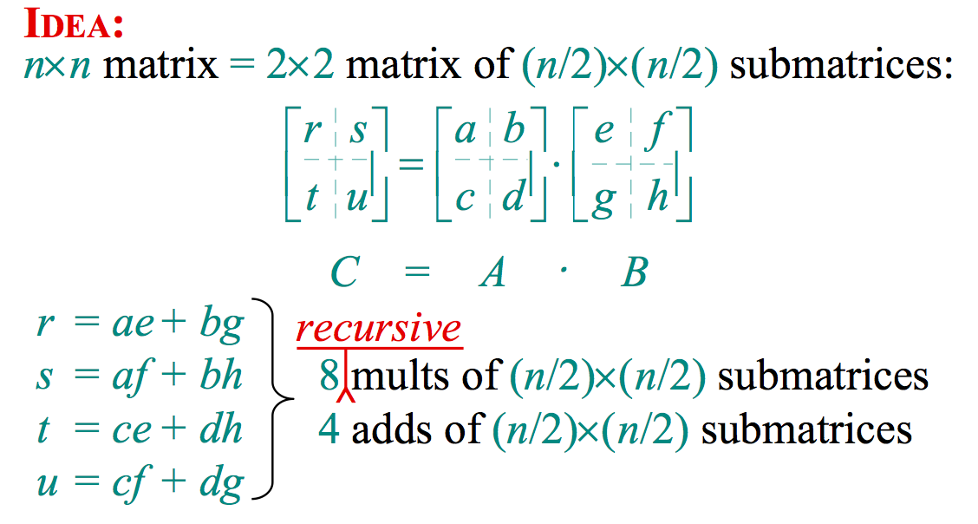
Divide-and-Conquer Algorithm

Slide 19
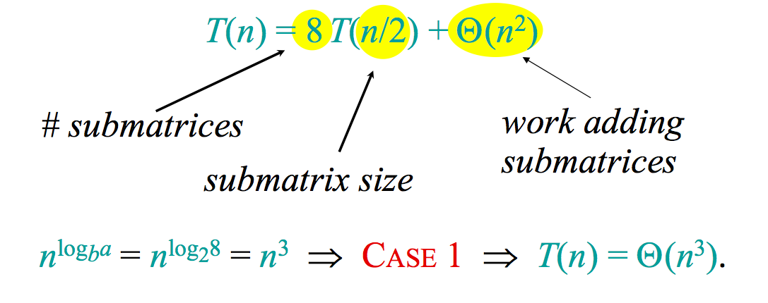

Analysis of D&C Algorithm

Slide 20
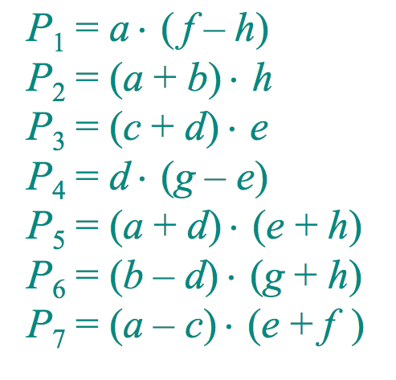
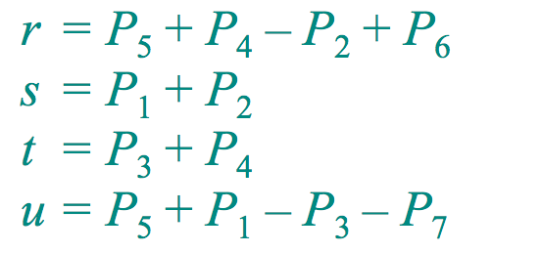
Strassen’s Idea
Multiply 2x2 matrices with only 7 multiplications
7 mults, 18 adds/subs

Slide 21
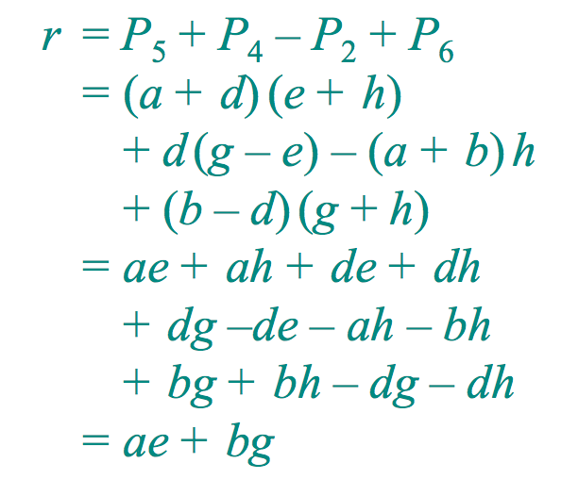
Strassen’s Idea
Multiply 2x2 matrices with only 7 multiplications

Slide 22
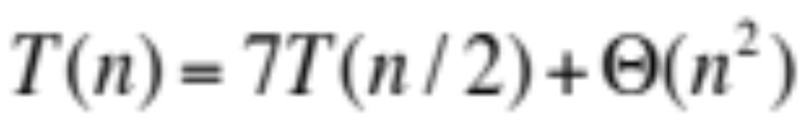
Strassen’s Algorithm
Divide: Partition A and B into (n/2)x(n/2) submatrices. Form terms to be multiplied using + and –
Conquer: Perform 7 multiplications of (n/2) x (n/2) submatrices recursively.
Combine: Form C using + and – on (n/2) x (n/2) submatrices

Slide 23
Analysis of Strassen
The number 2.81 may not be a lot smaller than 3 but being in the exponent has a significant effect.
Strassen algorithm beats ordinary algorithm for n >= 32

Slide 24
Conclusion
Divide and conquer is just one of several powerful techniques for algorithm design.
Divide-and-conquer algorithms can be analyzed using recurrences and the master method.
The divide-and-conquer strategy often leads to efficient algorithms.

